Slide 1

Chapter 4
Transmission Media
4.<number>

Slide 2

Figure 4.1 Transmission medium and physical layer
The world of computer networks would not exist
if there were no medium by which to transfer data
4.<number>

Slide 3

Figure 4.2 Classes of transmission media
Transmission media can be divided into two broad categories: guided and unguided.
Guided media include twisted-pair cable, coaxial cable, and fiber-optic cable.
Unguided medium is free space.
4.<number>

Slide 4
4-1 GUIDED MEDIA
Guided media, which are those that provide a conduit from one device to another, include twisted-pair cable, coaxial cable, and fiber-optic cable.
Topics discussed in this section:
Twisted-Pair Cable
Coaxial Cable
Fiber-Optic Cable
4.<number>

Slide 5
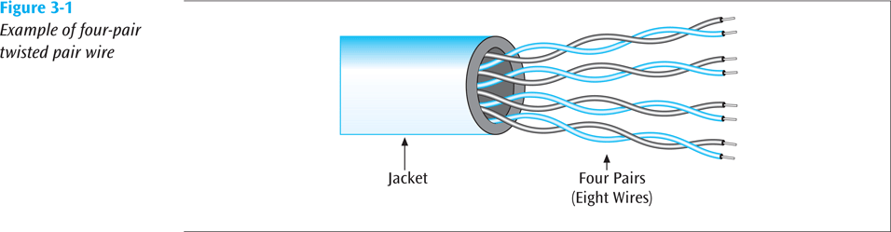
Twisted-pair cable
A twisted pair consists of two conductors (normally copper), each with its own plastic insulation, twisted together
Twisting the wires helps to eliminate electromagnetic interference between the two wires
Shielding can further help to eliminate interference
Figure 4.3 Twisted-pair cable
4.<number>

Slide 6
Unshielded Versus Shielded Twisted-Pair Cable
Unshielded twisted-pair (UTP).
Shielded twisted-pair (STP).
4.<number>

Slide 7

Figure 4.4 UTP and STP cables
STP cable has a metal foil covering that encases each pair of insulated conductors.
Although metal casing improves the quality of cable by preventing the penetration of noise or crosstalk,
It is more expensive.
4.<number>

Slide 8
Categories
The Electronic Industries Association (EIA) has developed standards to classify unshielded twisted-pair UTP cable into seven categories.
Twisted pair wire is classified by category. Twisted pair is currently Category 1 through Category 7, although Categories 1, 2 and 4 are nearly obsolete
4.<number>

Slide 9
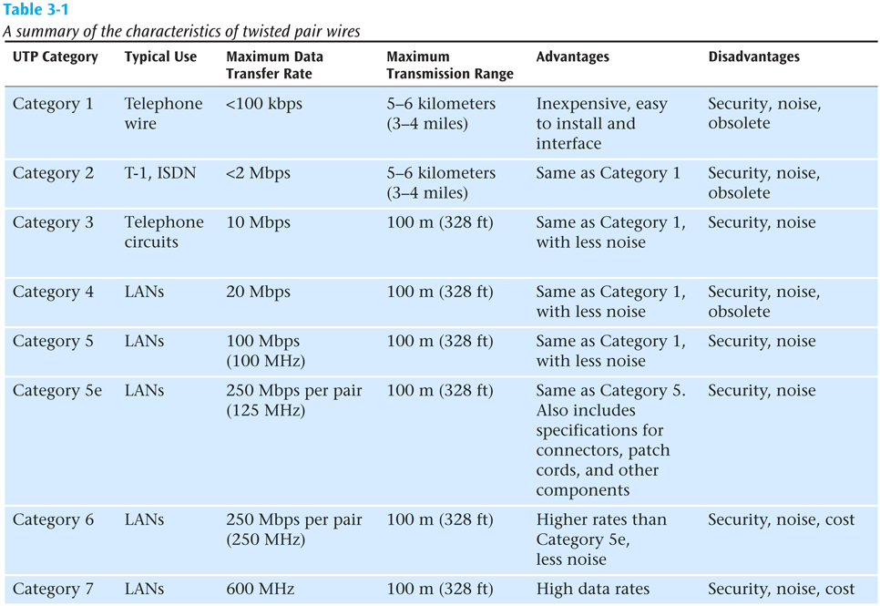
Table 4.1 Categories of unshielded twisted-pair cables
4.<number>

Slide 10

Figure 4.5 UTP connector
To connect the cable to a device we need a connector.
The most common UTP connector is RJ45
4.<number>
Notes:
RJ = Registered Jack.

Slide 11
Twisted Pair Summary
Most common form of wire
Relatively inexpensive
Easy to install
Carries high data rates (but not the highest)
Can suffer from electromagnetic noise
Comes in shielded and unshielded forms
4.<number>
Notes:
RJ = Registered Jack.

Slide 12
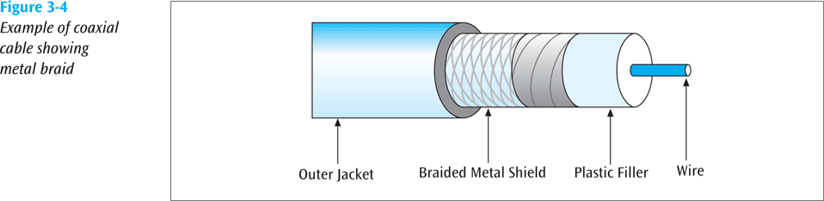
Coaxial Cable
Coaxial carries signals of higher frequency ranges than twisted pair cable.
A single wire wrapped in a foam insulation surrounded by a braided metal shield, then covered in a plastic jacket.
4.<number>
Notes:
RJ = Registered Jack.
foam insulation surroundedيحاط بعازل مطاطي

Slide 13
Coaxial Cable
Cable comes in various thicknesses
Baseband coaxial technology uses digital signaling in which the cable carries only one channel of digital data
Broadband coaxial technology transmits analog signals and is capable of supporting multiple channels
4.<number>
Notes:
RJ = Registered Jack.
foam insulation surroundedيحاط بعازل مطاطي

Slide 14
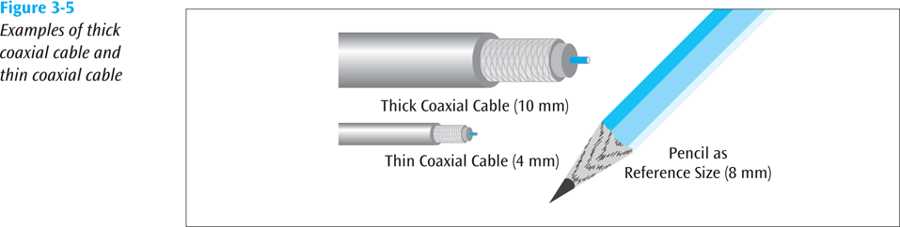
Figure 4.7 Coaxial Cable (continued)
4.<number>

Slide 15

Coaxial Cable Connectors
The most common type of connector used today is the Bayone-Neil-Concelman (BNC), connector.
The BNC connector is used to connect the end of the cable to a device(TV or PC).
The BNC T connector is used in Ethernet networks to branch
out to a connection to a computer or other device.
The BNC terminator is used at the end of the cable to prevent the reflection of the signal.
Figure 4.8 BNC connectors
4.<number>

Slide 16
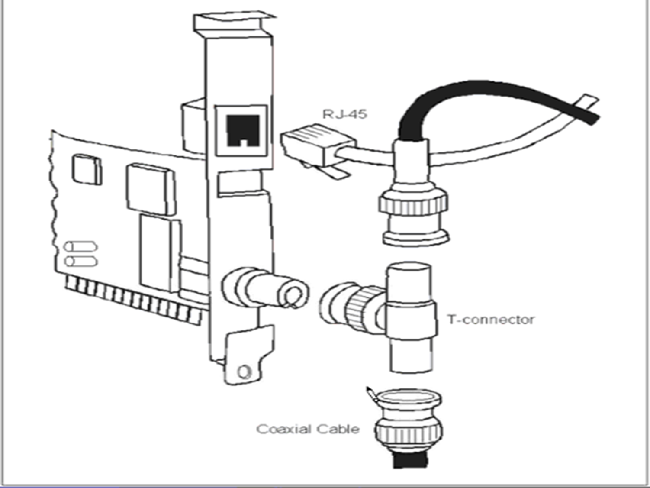
Coaxial Cable Connectors
4.<number>

Slide 17
Coaxial Cable Summary
A single wire surrounded by a shield
Because of shielding, can carry a wide bandwidth of frequencies
Thus is good with applications such as cable television
Not as easy to install as twisted pair
More expensive than twisted pair
4.<number>

Slide 18
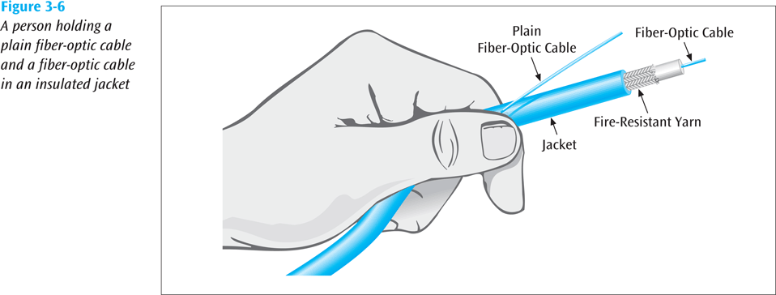
Fiber-Optic Cable
A fiber-optic cable is made of glass or plastic approximately a little thicker than a human hair and transmits signals in the form of light.
4.9
4.<number>

Slide 19
Fiber-Optic Cable (continued)
Fiber-optic cable is capable of supporting millions of bits per second for 1000s of meters
Thick cable (62.5/125 microns) causes more ray collisions, so you have to transmit slower. This is step index multimode fiber. Typically use LED for light source, shorter distance transmissions
Thin cable (8.3/125 microns) – very little reflection, fast transmission, typically uses a laser, longer transmission distances; known as single mode fiber
4.<number>

Slide 20
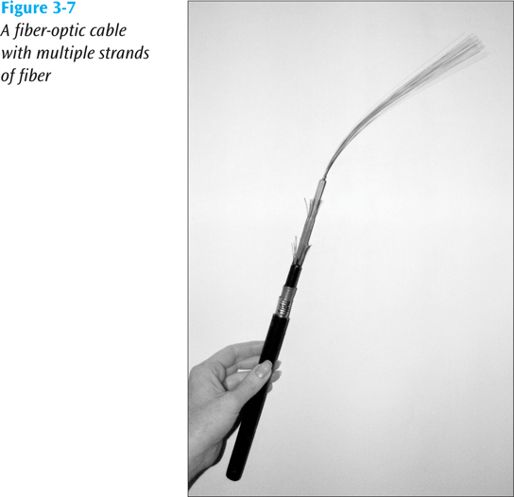
Fiber-Optic Cable (continued)
4.<number>

Slide 21
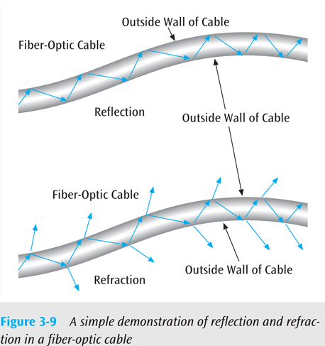
Fiber-Optic Cable (continued)
Fiber-optic cable is susceptible to reflection (where the light source bounces around inside the cable) and refraction (where the light source passes out of the core and into the surrounding cladding)
Thus, fiber-optic cable is not perfect either. Noise is still a potential problem
7.11
7.9
4.<number>

Slide 22
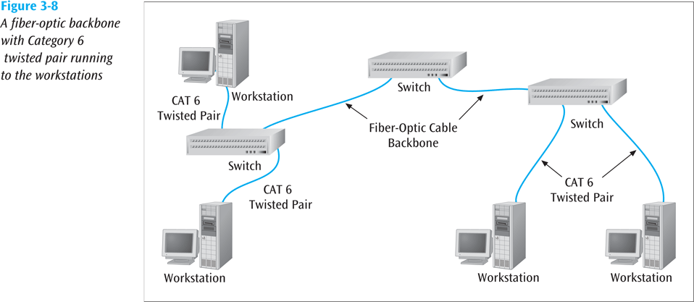
Fiber-Optic Cable (continued)
4.10
4.<number>

Slide 23
Advantages of Optical Fiber
Higher bandwidth. Fiber-optic cable can support dramatically higher bandwidths (and hence data rates) than either twisted-pair or coaxial cable.
Less signal attenuation. Fiber-optic transmission distance is significantly greater than that of other guided media. A signal can run for 50 km without requiring regeneration. We need repeaters every 5 km for coaxial or twisted-pair cable.
Immunity to electromagnetic interference. Electromagnetic noise cannot affect fiber-optic cables.
Resistance to corrosive materials. Glass is more resistant to corrosive materials than copper.
Light weight. Fiber-optic cables are much lighter than copper cables.
Greater immunity to tapping. Fiber-optic cables are more immune to tapping than copper cables.
4.<number>
Notes:
Corrosive=التآكل
Bandwidth=عرض النطاق

Slide 24
Disadvantages of Optical Fiber
Installation and maintenance. Fiber-optic cable is a relatively new technology. Its installation and maintenance require expertise that is not yet available everywhere.
Unidirectional light propagation. Propagation of light is unidirectional. If we need bidirectional communication, two fibers are needed.
Cost. The cable and the interfaces are relatively more expensive than those of other guided media.
4.<number>

Slide 25
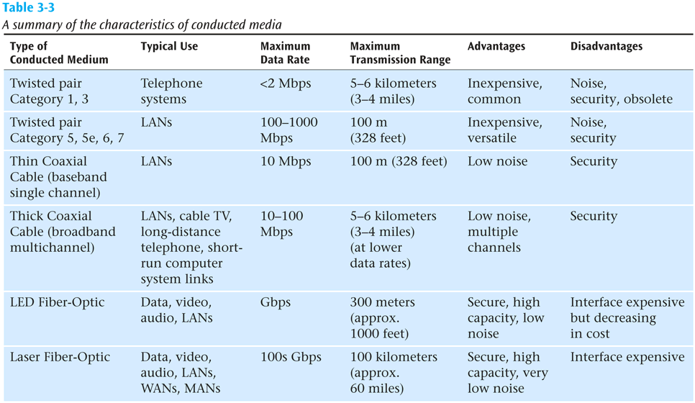
Conducted Media
4.<number>

Slide 26
4-2 UNGUIDED MEDIA: WIRELESS
Unguided media transport electromagnetic waves without using a physical conductor. This type of communication is often referred to as wireless communication.
Topics discussed in this section:
Radio Waves
Microwaves
Infrared
4.<number>

Slide 27

Propagation methods
Unguided signals can travel from the source to destination in several ways:
  Ground propagation,
  Sky propagation,
  Line-of-sight propagation.
Figure 4.11 Propagation methods
4.<number>

Slide 28
Propagation methods
In ground propagation, radio waves travel through the lowest portion of the atmosphere, hugging the earth. These low-frequency signals emanate in all directions from the transmitting antenna and follow the curvature of the planet.
4.<number>

Slide 29
Propagation methods
In sky propagation, higher-frequency radio waves.The signal travels from a ground station on earth to a satellite and back to another ground station.
4.<number>
Notes:
Radiate-=يشع

Slide 30
sky propagation - Satellite Microwave Transmission
Satellites can be classified by how far out into orbit each one is
(LEO, MEO, GEO, and HEO)
4.<number>

Slide 31
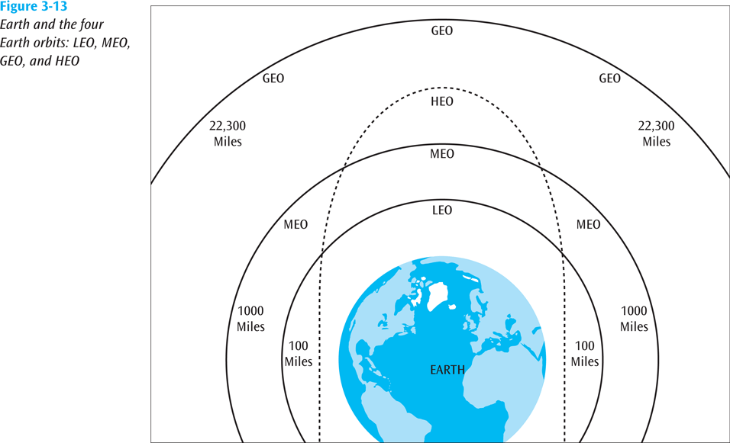
sky propagation - Satellite Microwave Transmission
Figure 4.12
4.<number>

Slide 32
sky propagation - Satellite Microwave Transmission (continued)
LEO (Low-Earth-Orbit) – 100 to 1000 miles out
  Used for wireless e-mail, special mobile telephones, spying, videoconferencing
MEO (Middle-Earth-Orbit) – 1000 to 22,300 miles
  Used for GPS (global positioning systems).
GEO (Geosynchronous-Earth-Orbit) – 22,300 miles
  Always over the same position on earth (and always over the equator)
  Used for weather, television.
4.<number>

Slide 33
sky propagation - Satellite Microwave Transmission (continued)
HEO (Highly Elliptical Earth orbit) – satellite follows an elliptical orbit
  Used by the military for spying and by scientific organizations for photographing celestial bodies
4.<number>

Slide 34
Propagation methods
In line-of-sight propagation, very high-frequency signals are transmitted in straight lines directly from antenna to antenna. Antennas must be directional, facing each other and either tall enough or close enough together not to be affected by the curvature of the earth.
4.<number>

Slide 35
Propagation methods
Approximately 20-30 miles between towers
Transmits data at hundreds of millions of bits per second
Signals will not pass through solid objects
Popular with telephone companies and business to business transmissions
4.<number>

Slide 36
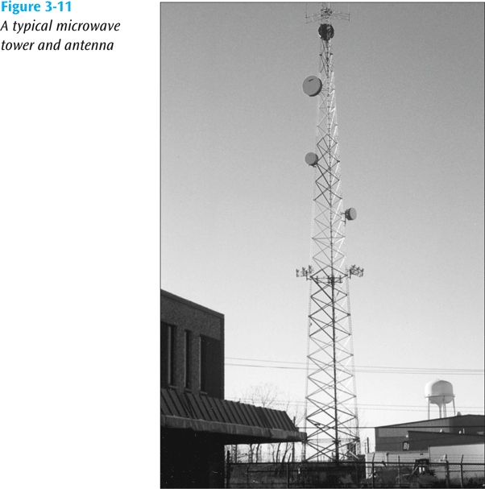
line-of-sight propagation (continued)
Figure 4.13
4.<number>

Slide 37
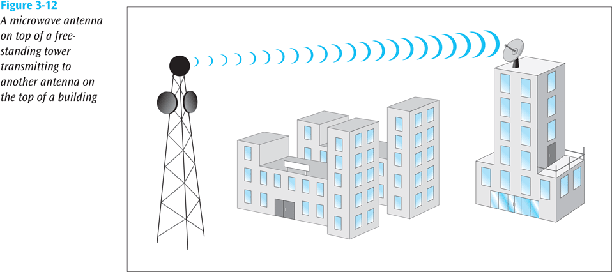
line-of-sight propagation (continued)
Figure 4.14
4.<number>

Slide 38

Wireless transmission waves
We can divide wireless transmission into three broad groups: radio waves, microwaves, and infrared waves.
Figure 4.15 Wireless transmission waves
4.<number>

Slide 39

Radio Waves
Electromagnetic waves ranging in frequencies between 3 kHz and 1 GHz are normally called radio waves; waves ranging in frequencies between 1 and 300 GHz are called microwaves.
Radio waves use omnidirectional antennas that send out signals in all directions.
Figure 4.16 Omnidirectional antenna
4.<number>

Slide 40

Note
Radio waves are used for multicast communications, such as radio and television.
4.<number>

Slide 41
Microwaves
Microwaves are unidirectional. When an antenna transmits microwave waves, they can be narrowly focused. This means that the sending and receiving antennas need to
be aligned.
4.<number>

Slide 42
Microwaves
The following describes some characteristics of microwave propagation:
Microwave propagation is line-of-sight. Since the towers with the mounted antennas need to be in direct sight of each other, towers that are far apart need to be very tall. The curvature of the earth as well as other blocking obstacles do not allow two short towers to communicate by using microwaves. Repeaters are often needed for long distance
communication.
Very high-frequency microwaves cannot penetrate walls. This characteristic can be a disadvantage if receivers are inside buildings.
4.<number>

Slide 43

Figure 4.21 Unidirectional antennas
4.<number>

Slide 44
Note
Microwaves are used for unicast communication such as cellular telephones, satellite networks,
and wireless LANs.
4.<number>

Slide 45
Infrared
Infrared waves can be used for short-range communication.
Infrared waves, having high frequencies, cannot penetrate walls. This advantageous characteristic prevents interference between one system and another; a short-range communication system in one room cannot be affected by another system in the next room.
Example, when we use our infrared remote control, we do not interfere with the use of the remote by our neighbors.
However, this same characteristic makes infrared signals useless for long-range communication. In addition, we cannot use infrared waves outside a building because the sun's rays contain infrared waves that can interfere with the communication.
4.<number>

Slide 46
Note
Infrared signals can be used for short-range communication in a closed area using line-of-sight propagation.
4.<number>

Slide 47
Media Selection Criteria
Cost
Speed
Distance and expandability
Environment
Security
4.<number>

Slide 48
Media Selection Criteria
Cost
Different types of costs
  Initial cost – what does a particular type of medium cost to purchase? To install?
  Maintenance / support cost
Speed
  Propagation speed – the time to send the first bit across the medium
  Data transfer speed – the time to transmit the rest of the bits in the message
4.<number>

Slide 49
Media Selection Criteria
Distance and expandability
  Certain media lend themselves more easily to expansion
Environment
Electromagnetic noise
Security
  If data must be secure during transmission, it is important that the medium not be easy to tap
  Make the wire impervious to electromagnetic wiretapping
  Encrypt the signal going over the medium
4.<number>

